Slide 1
Technology in Education: The good, bad, the ugly, and the future
Philip Johnson
Collaborative Software Development Laboratory
Information and Computer Sciences
University of Hawaii
Honolulu, HI USA

Slide 2
Let's start with the bad
Notes:
Hold up my cell phone, ask them to do the same, Turn mine off, ask them to do the same. Ask how they feel now. Ask how they will feel in 30 minutes.
Symptoms of cell phone withdrawal: sweaty palms, inability to think about anything other than your cell phone, fear of missing out.

Slide 3
Symptoms of cell phone addiction
Use of cell phone to lift your mood.
Need to increase cell phone use to achieve same mood elevation.
Loss of cell phone or battery causes anxiety/panic.
Cell phone use interferes with social or life goals.
https://student.societyforscience.org/article/watch-out-cell-phones-can-be-addictive
Notes:
Average college student uses smart phone for 9 hours a day (more than they spend sleeping)

Slide 4
What does cell phone addiction have to do with technology and education?

Slide 5
Multi-tasking and Learning
Finding 1: Students who kept their laptops closed during lectures remembered more.
Finding 2: Students who check email, look at Facebook, text, listen to music, watch TV while studying spend only 65% of their time actually focused on learning.
http://www.ugr.es/~victorhs/gbd/docs/10.1.1.9.9018.pdf
http://blogs.kqed.org/mindshift/2013/05/how-does-multitasking-change-the-way-kids-learn/

Slide 6
Impact of multi-tasking on learning
Assignment takes longer to complete
Mental fatigue from task-switching leads to more mistakes.
Decreased ability to remember material later.
Distractions while learning means brain processes information in different, less useful ways.
http://blogs.kqed.org/mindshift/2013/05/how-does-multitasking-change-the-way-kids-learn/
Notes:
Multi-tasking inhibits ability to extend and extrapolate knowledge to new contexts.

Slide 7
If you don't multitask, you can study for half as long and get the same grade.
So why don't you do this?

Slide 8
Continuous Partial Attention
Constant scanning of environment for stimulation and interesting details is easier than trying to maintain focused attention on a difficult task.
Social apps are designed to encourage continuous partial attention.
http://www2.yk.psu.edu/student-affairs/2012/02/learning-and-multitasking-can-we-do-both/

Slide 9
Technology and Education: The Bad
Our culture celebrates the "multi-taskers".
Technology companies make money based upon the "stickiness" of their applications.
Key demographic for many companies is 18-34 year olds, which includes all college-age students.

Slide 10
You are bombarded by technology that is designed to be bad for your education

Slide 11


So what about the good?

Slide 12
Online education
A gifted teacher + the internet = amazing opportunity
But it requires incredible discipline to learn.
Coursera failure rate > 90% for 80% of courses.
http://www.katyjordan.com/MOOCproject.html

Slide 13
The Holy Grail
Use technology for education:
To exploit availability of online video etc.
To support anyplace/anytime learning
To IMPROVE focus, retention, extrapolation
To DECREASE time required to learn material deeply.
To do this at the University of Hawaii!!

Slide 14
How can I create "deep" learning in my courses?

Slide 15
Deep learning: capabilities
Capabilities
Create
Deep
Evaluate
Analyze
Apply
Understand
Remember
Shallow
http://en.wikipedia.org/wiki/Bloom%27s_taxonomy

Slide 16
Deep learning: techniques
Capabilities
Techniques
Teach others
Create
Deep
Practice by doing
Evaluate
Discussion group
Analyze
Demonstration
Apply
Audio-Visual
Understand
Lecture/Reading
Remember
Shallow

Slide 17
Deep learning: results
Capabilities
Techniques
Retention
Teach others
90%
Create
Deep
Practice by doing
75%
Evaluate
Discussion group
Analyze
50%
Demonstration
Apply
30%
Audio-Visual
20%
Understand
Lecture/Reading
10%
Remember
Shallow

Slide 18

Evolution of my attempts to support deep learning

Slide 19




Approach: Survey text + lecture

Slide 20
Result
Approach | Significant strength | Significant weakness
Survey + Lecture | High quality texts | Low engagement

Slide 21
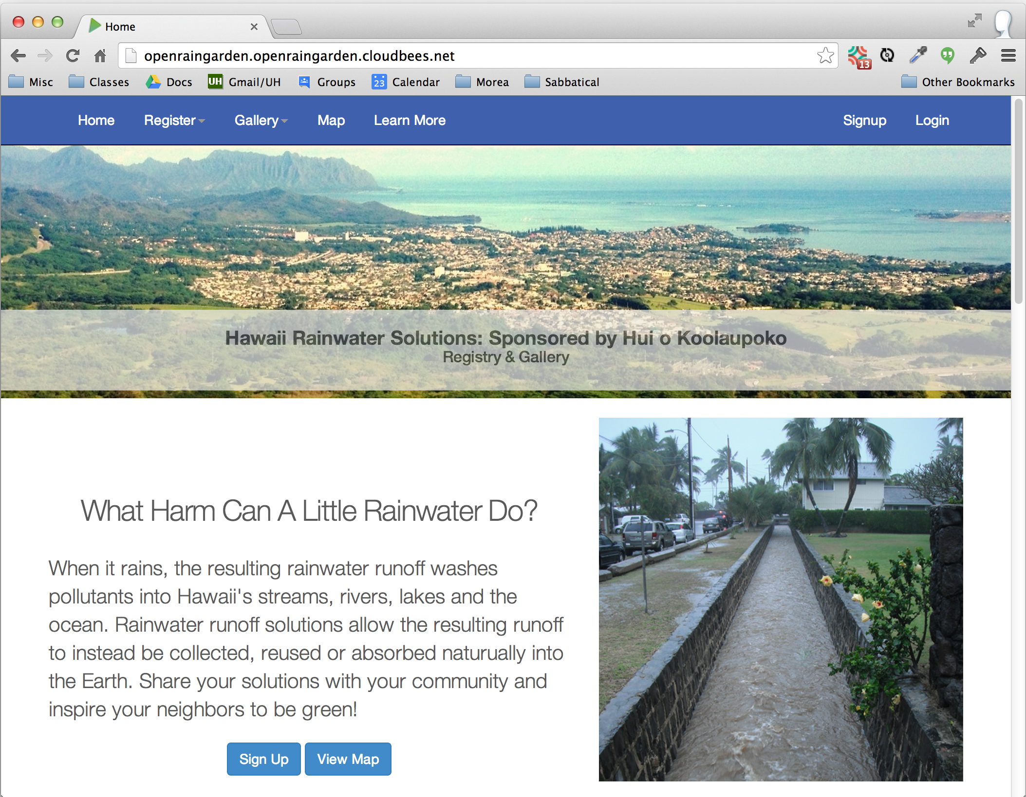
Approach: Community projects

Slide 22
Result
Approach | Significant strength | Significant weakness
Survey + Lecture | High quality texts | Low engagement
Community projects | High potential engagement | Variability in engagement

Slide 23

Approach: Flipped classroom

Slide 24
Result
Approach | Significant strength | Significant weakness
Survey + Lecture | High quality texts | Low engagement
Community projects | High potential engagement | Variability in engagement
Flipped classroom | "Active" classrooms | 60 min YouTube videos

Slide 25
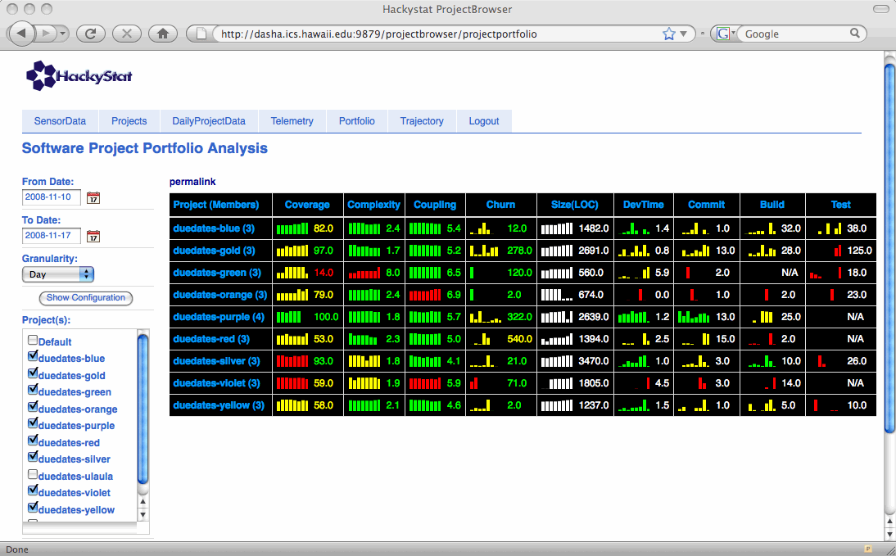
Approach: Super Metrics!

Slide 26
Result
Approach | Significant strength | Significant weakness
Survey + Lecture | High quality texts | Low engagement
Community projects | High potential engagement | Variability in engagement
Flipped classroom | "Active" classrooms | 60 min YouTube videos
Super Metrics | Fine grained insight into developer behavior | Complexity

Slide 27
Today: Athletic Software Engineering

Slide 28


Slide 29


Slide 30
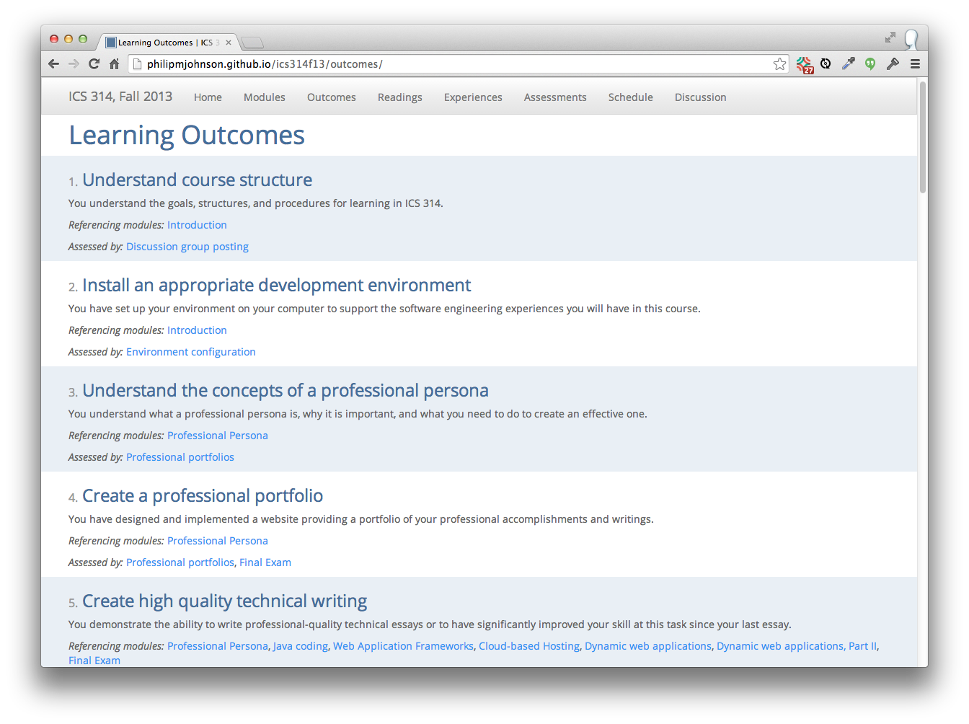

Slide 31
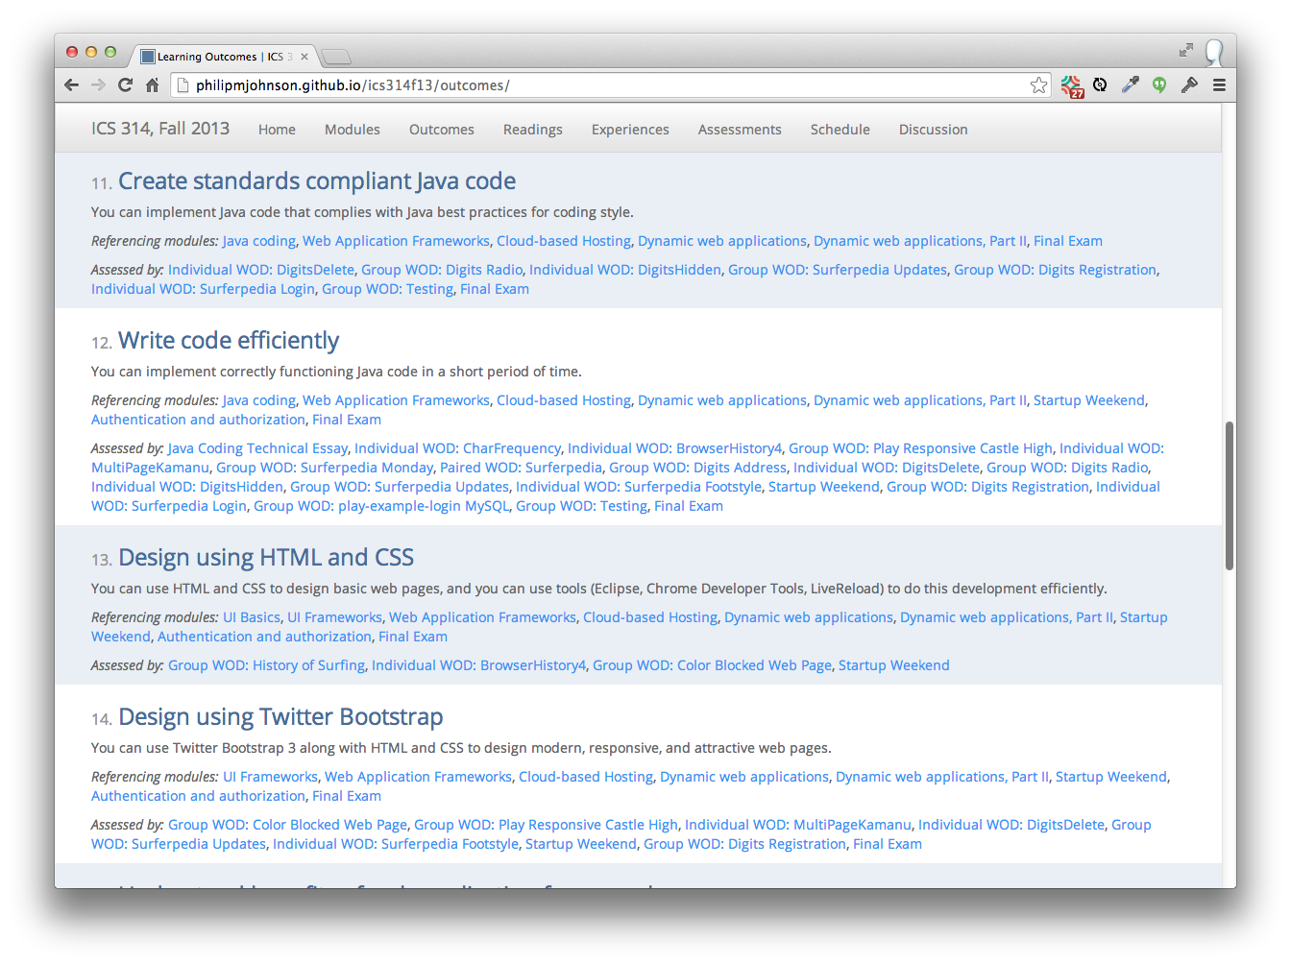

Slide 32
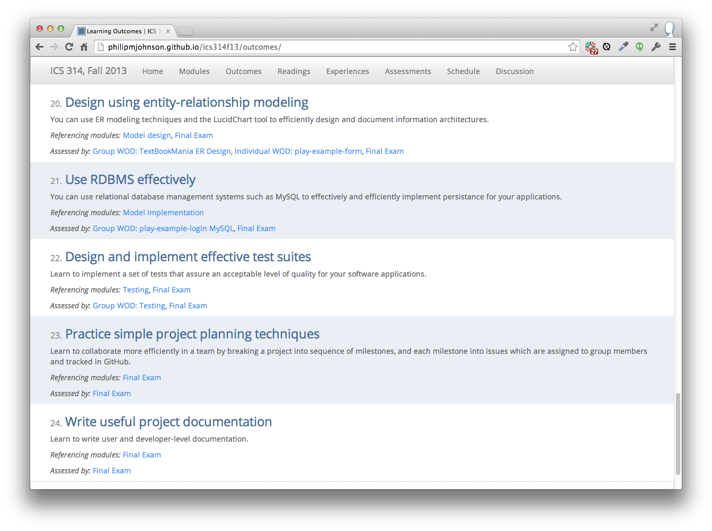

Slide 33


Slide 34


Slide 35


Slide 36
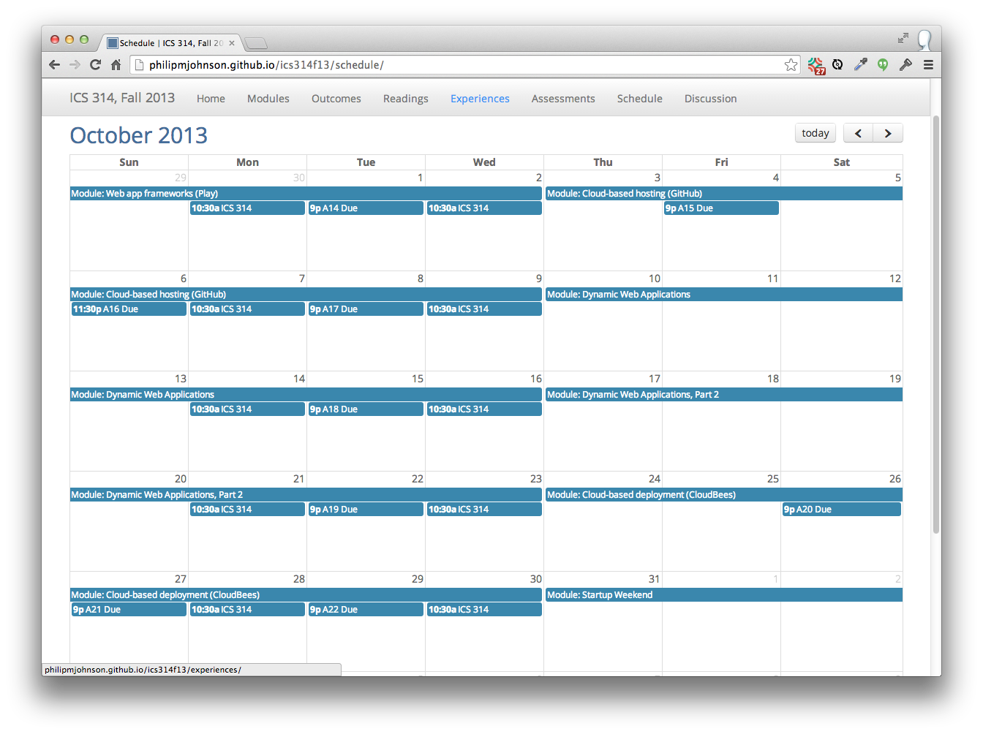

Slide 37
So, where's the "athletic"?

Slide 38
Making it athletic
"Workouts", not "classes"

Slide 39
Making it athletic
"DNF" (Did not finish)
No credit if you take too long

Slide 40
Making it athletic
Organize material into "skills".
"Fluency" with a skill can be tested in <45 minutes.
Instructor demonstrates "fluency" via YouTube videos.

Slide 41
Making it athletic
No reward for "heroic efforts"

Slide 42
Example
Skill:
Develop fluency designing responsive HTML5 user interfaces using Twitter Bootstrap

Slide 43
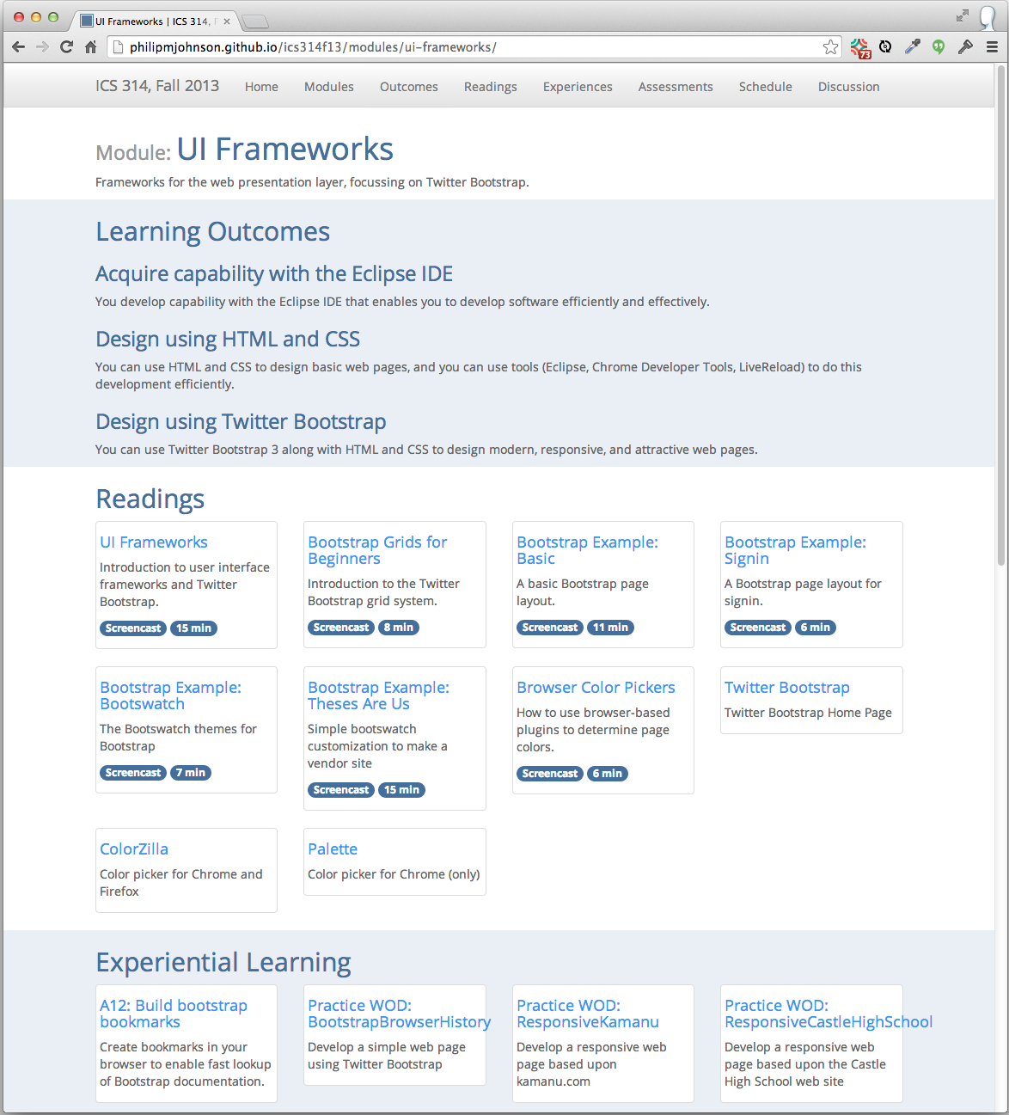

Slide 44
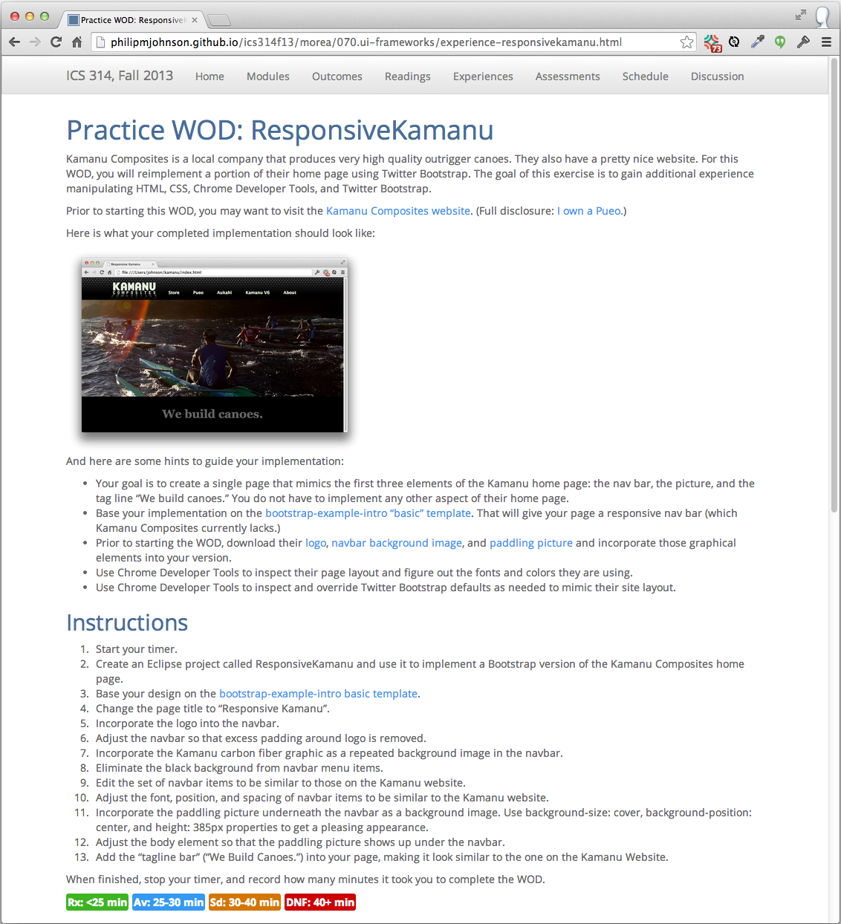

Slide 45
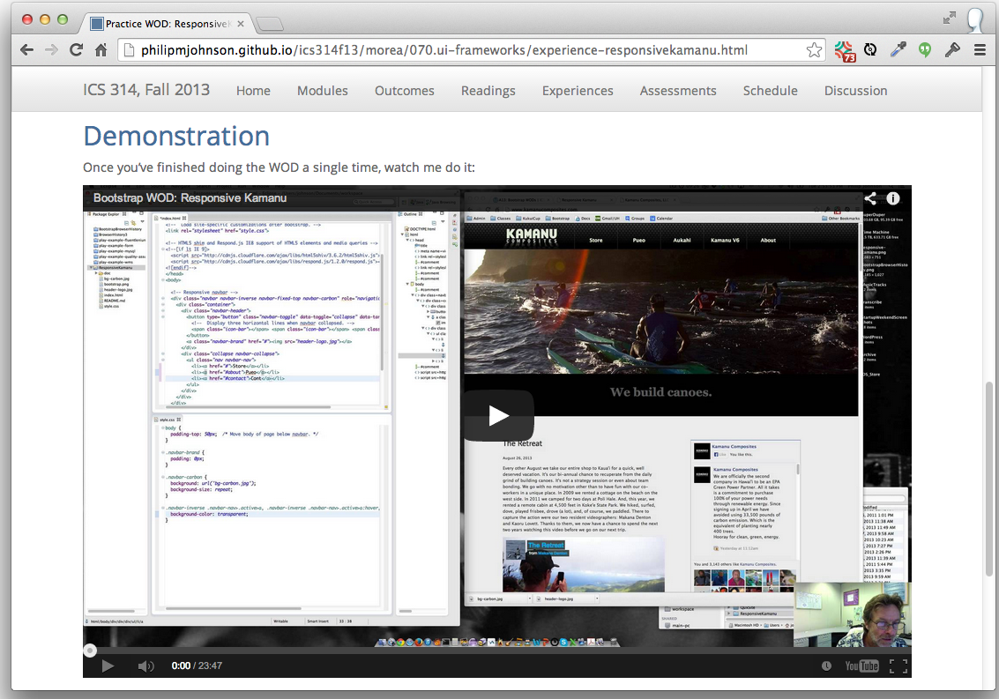

Slide 46
Question: How to assess if a student has achieved "fluency"?

Slide 47
Answer: The "WOD" (Workout of the Day)
Each Wednesday, students take a timed test to see if they have achieved "fluency" for that module
If they do not solve the problem both quickly and correctly, they get no credit for the module.

Slide 48
WOD Logistics
How do you
(1) individually time every student in the class,
(2) verify each student did the problem correctly?

Slide 49
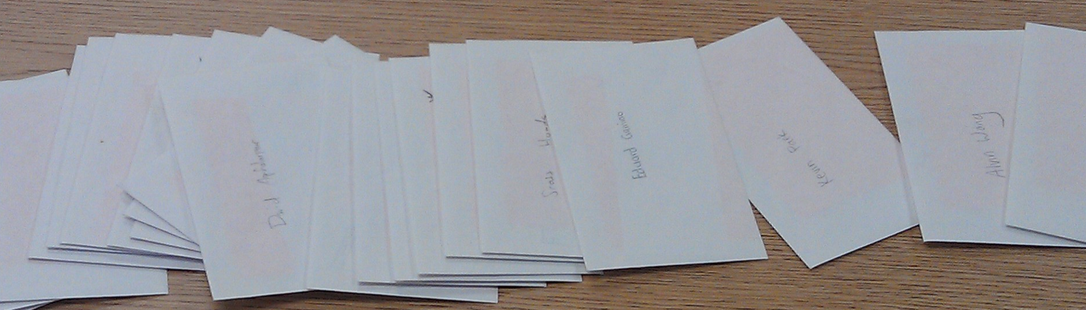
Each student has an envelope
I keep envelopes between WODs

Slide 50
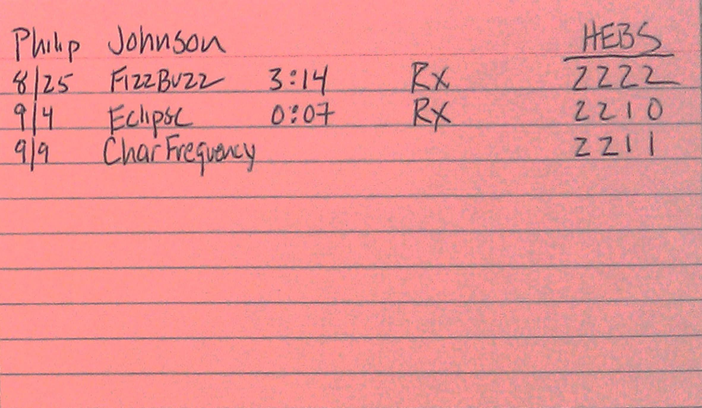
Envelopes contain index card
with results from all WODs

Slide 51
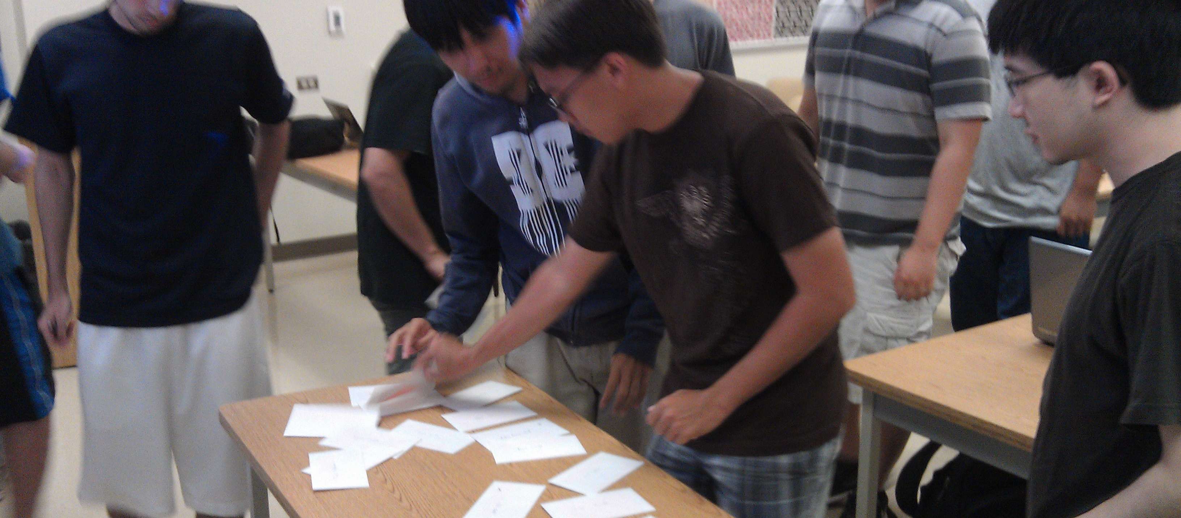
Students get their card
and write date and WOD name

Slide 52

Once class is ready: I provide URL to WOD and start timer

Slide 53
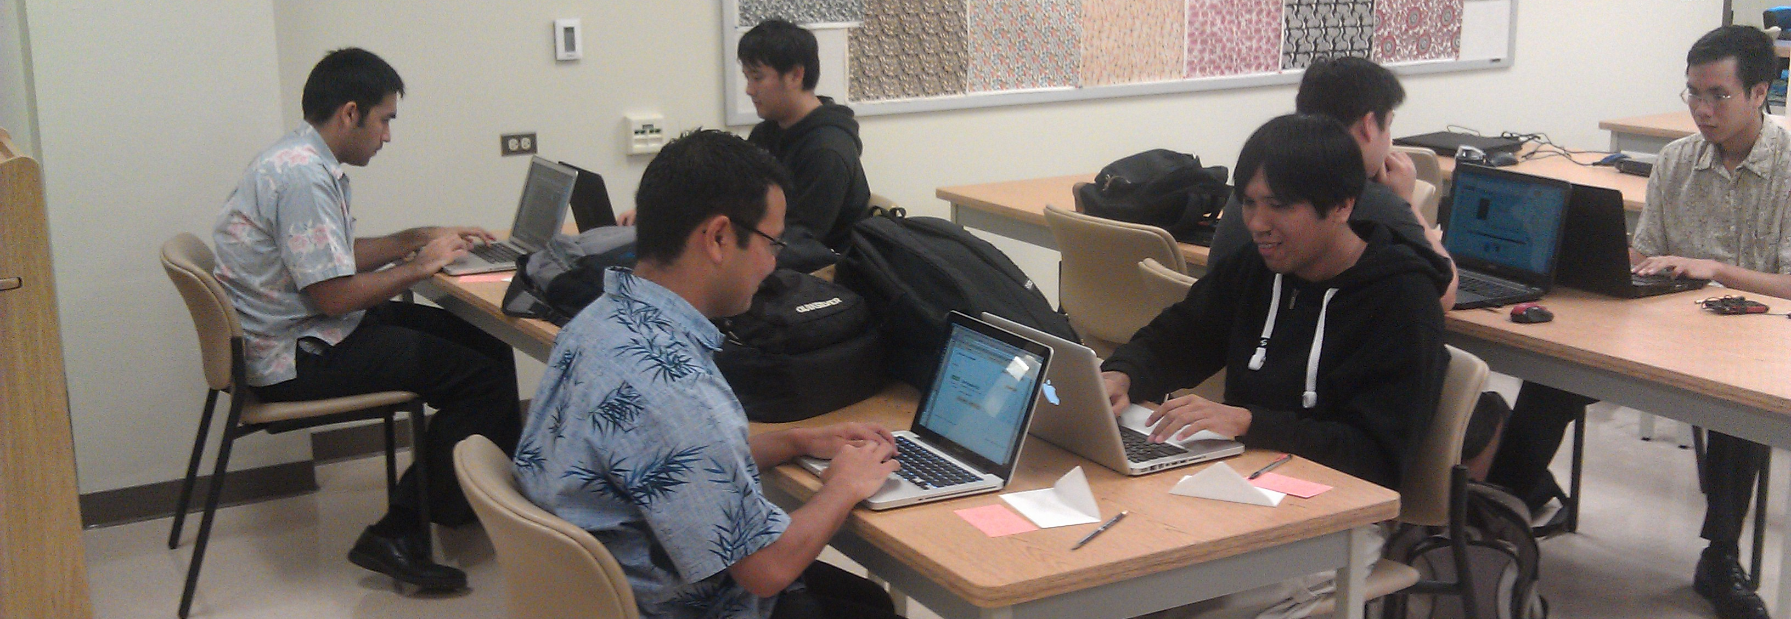
Students race against the clock
to finish WOD correctly

Slide 54

When finished, students raise hand
I record elapsed time on their card

Slide 55

Early finishers wait outside
An informal "Winners Circle"

Slide 56
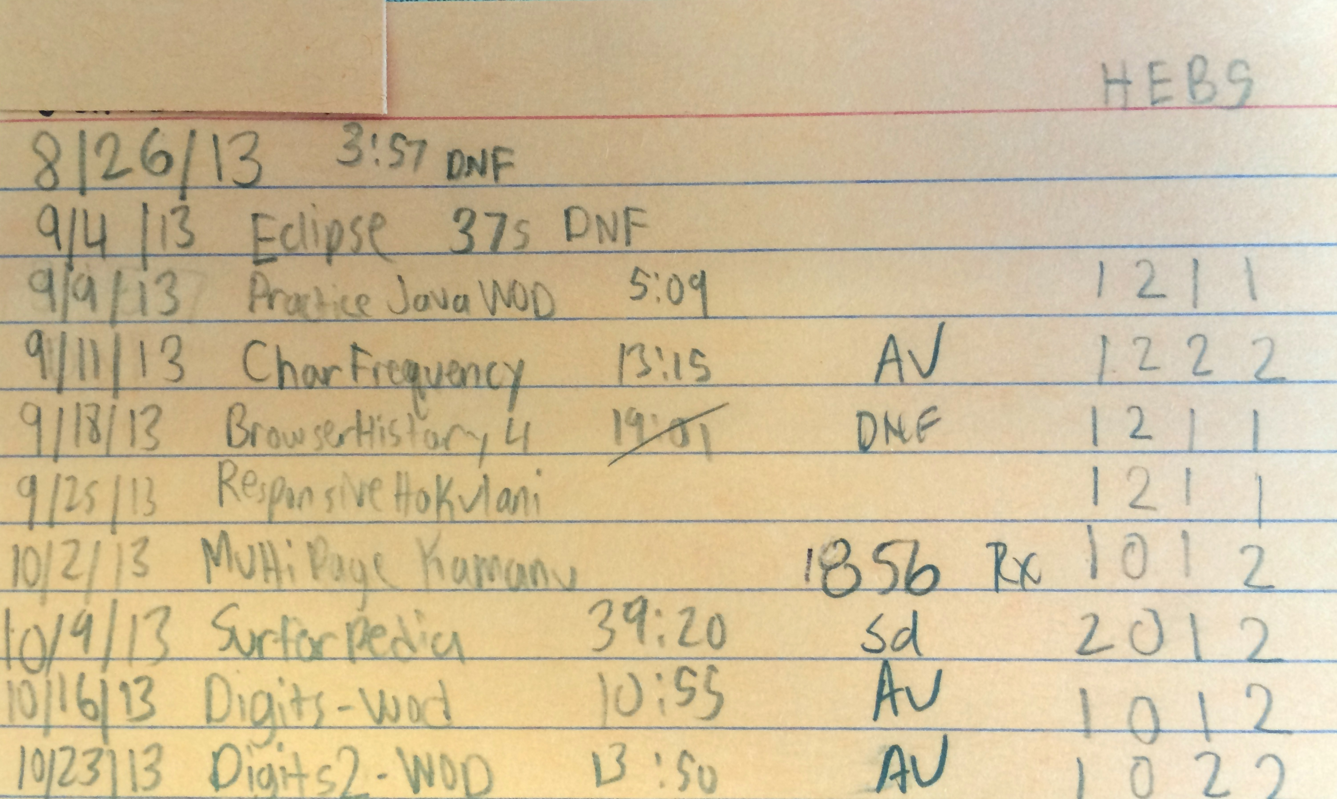
After class, I check submission
If incorrect, "DNF", no credit

Slide 57
3 Steps to Athletic Learning
1. Design a sequence of modules providing "skills" to be mastered.
2. For each module, provide students with:
sample problems requiring use of a skill
solution videos to each problem showing "mastery" of skill, time needed when "fluent"
3. Assess mastery through an in-class test where students are given a new problem to solve in a limited amount of time.

Slide 58
So how did this work out?

Slide 59
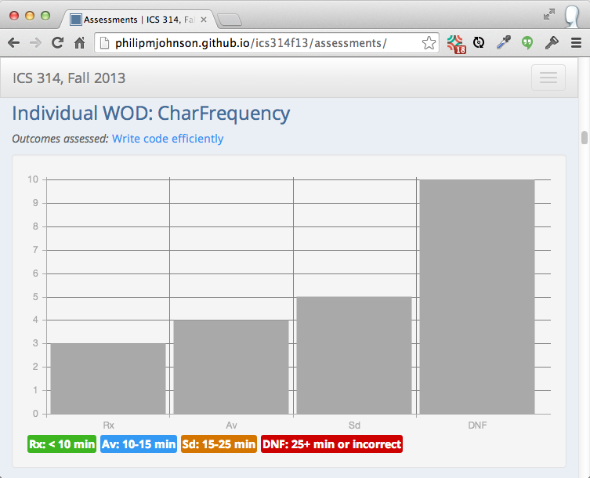
Outcome: WODs are stressful...

Slide 60
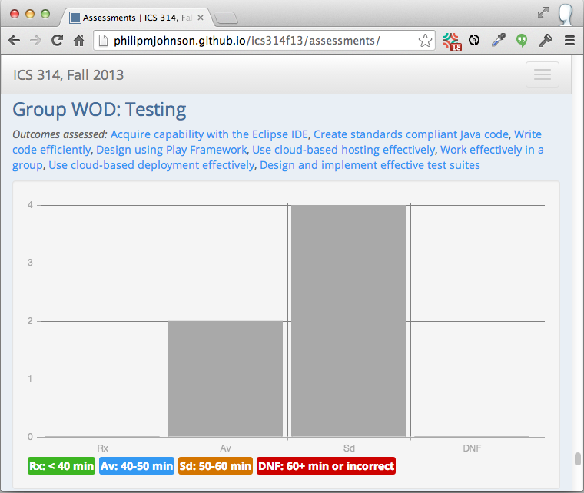
... but humans habituate

Slide 61
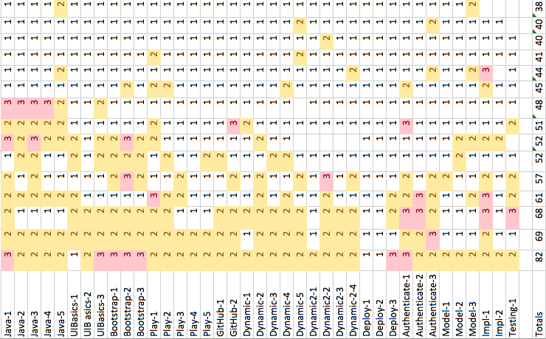
Outcome: Students practiced!

Slide 62
Practice WOD statistics
Every student repeated at least one practice WOD.
Over half the students repeated at least 12 practice WODs.
One student made 82 attempts at the 39 practice WODs.

Slide 63
For the first time in 25 years, students solve my homework assignments multiple times.

Slide 64

Outcome: Increased confidence
50% participation, up from 0% in 2012

Slide 65
Outcome: students like it
100% of the students prefer athletic approach to traditional course structure

Slide 66
Student Evaluations
"I learn more this way due to having to remember what I’ve done rather than searching how to do something and then forgetting soon after."

Slide 67
Student Evaluations
"During my initial attempt at the WODs, I may implement a solution that achieved the goal but was inefficient or poorly coded.
Being able to watch the solution and repeat the WODs helped to solidify the material we were learning."

Slide 68
Student Evaluations
"The in-class WODs simply reinforced what I should have practiced beforehand.
Whenever I DNF’ed an in-class WOD it was because I didn’t practice enough beforehand. "

Slide 69
Student Evaluations
"I think the WODs did inadvertently produce competitive feelings but it was not a negative feeling.
Rather, it was a great way to push me to work harder if I felt that I was lagging behind my fellow classmates."

